Slide 1
Movie Recommender System -Team Whatflix-
ByungHyun Lee
JunYeong Ahn
JiHong Jeong

Slide 2


Goal
‘To develop unique movie recommendation system,
mainly based on similarity analysis’

Slide 3
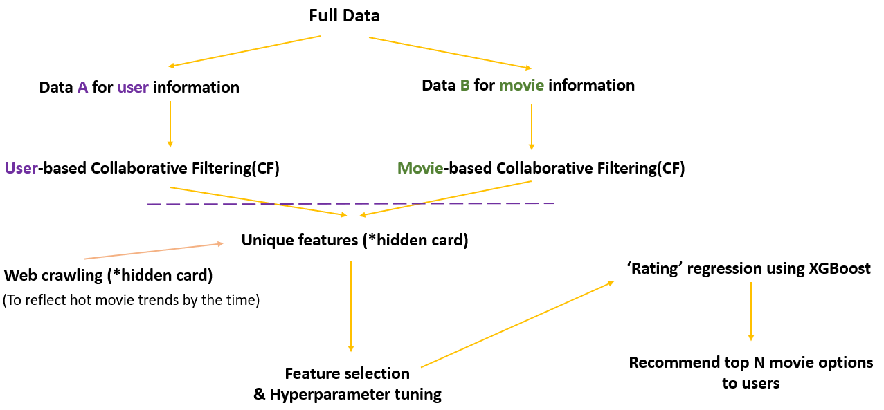
The Schema of System
,,,sophisticated!

Slide 4
Broad Steps
1) With data, two ‘CFs’ are constructed through
calculating some similarities.
2) Results from them will be diverted into features
for ML modeling.
3) The model predicts ratings for certain movies
– regression!
=> Five movies will be recommended

Slide 5
Let’s Assume That We Start Our Service
Congratulation! You’ve just got a chance to be a new user of our service.
We want to recommend some movies based on similarities
between you and someone but…
WE DON’T KNOW YOU!

Slide 6
We Call It ‘Cold Start’
-Cold Start Problem
It is hard to properly treat you, whose information is nowhere.
Solution1 : Quick survey
Solution2 : Hot-Movie Trend
- Through *web-crawling

Slide 7
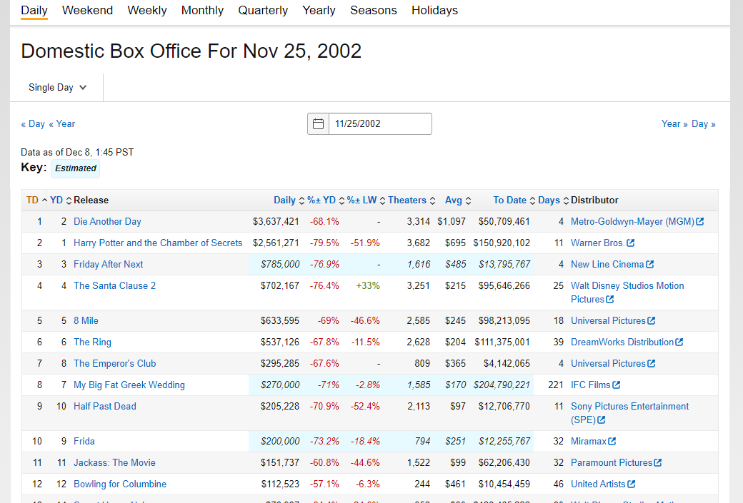
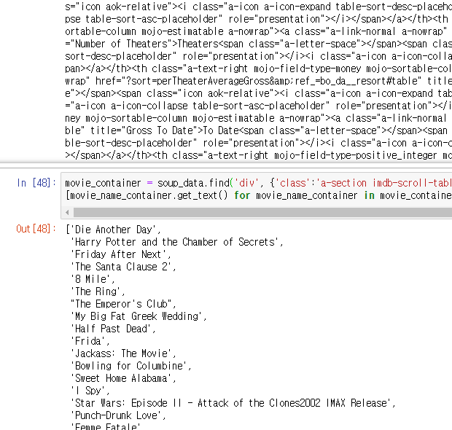
Web-Crawling?

Slide 8
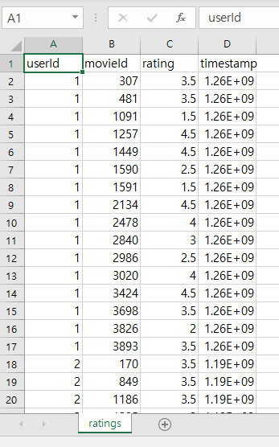
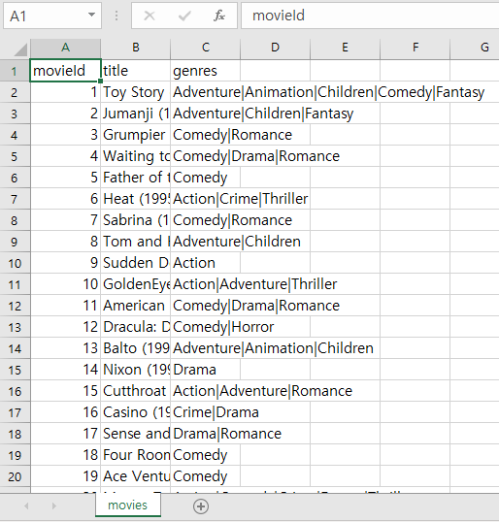
Now, We’ve Collected a Lot Data!
-For User-Based similarity calculations
-For Content-Based similarity calculations
‘User’
‘Movie’

Slide 9
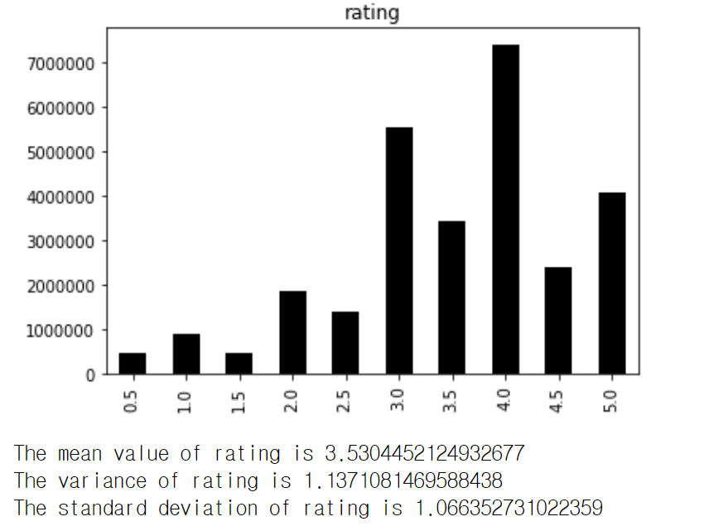
EDA

Slide 10
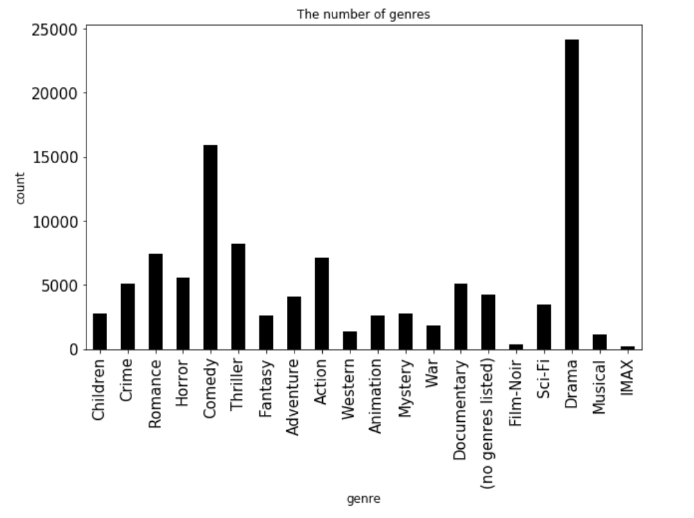
EDA

Slide 11
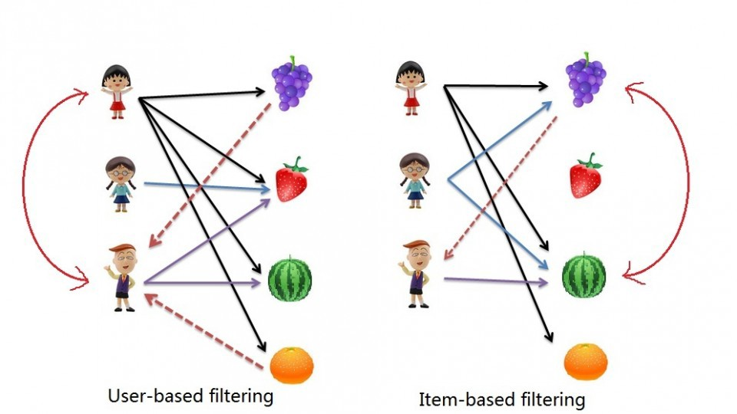
Collaborative Filtering(CF)

Slide 12
About User Based Filtering
User
User
User
Movie
Rating

Slide 13
About Contents Based Filtering
Contents
Contents
Title
Genre
Actor
Film maker
Tag

Slide 14
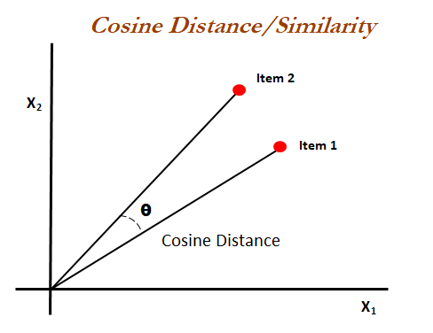

Cosine Similarity
A method of calculating similarity between two vectors
$similarity=\cos\left(θ\right)= \frac{A∙B}{\left\|A\right\|\left\|B\right\|}$
A = [1 0 1 0 0 0 1 1 0 0 0 1]
B = [0 1 0 0 1 1 1 1 0 0 0 1]
$sim= \frac{3}{\sqrt{5}×\sqrt{6}}=\text{0.5477225575}$

Slide 15
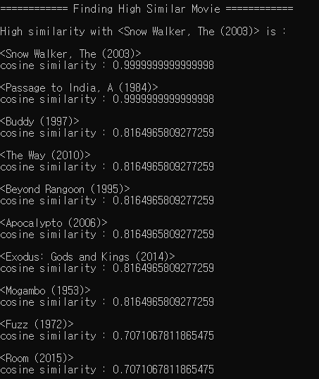
Applying on Movie Data
Snow Walker, The (2003) Adventure|Drama
Passage to India, A (1984) Adventure|Drama
Buddy (1997) Adventure|Children|Drama
The Way (2010) Adventure|Comedy|Drama

Slide 16
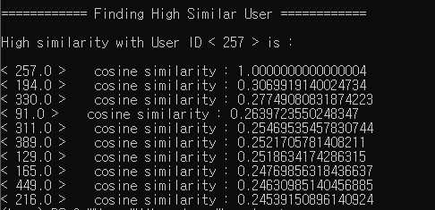
Applying on User Data
User Id 257 | Movie 7 | Rating 1
257 | 16 | 3.5
257 | 112 | 3.5
257 | 370 | 3.5
257 | 420 | 4
257 | 494 | 3
257 | 594 | 3.5
257 | 653 | 4
257 | 784 | 3.5
257 | 1288 | 4.5
257 | 1304 | 2.5
257 | 1380 | 4
257 | 1500 | 2
257 | 2406 | 3.5
257 | 2502 | 1.5
257 | 2599 | 1.5
257 | 2791 | 3.5
257 | 3996 | 4.5
257 | 5445 | 4
257 | 5952 | 3
User Id 194 | Movie 48 | Rating 2
194 | 163 | 3
194 | 168 | 3.5
194 | 315 | 3.5
194 | 342 | 3.5
194 | 552 | 3.5
194 | 784 | 3
194 | 1035 | 4
194 | 1090 | 4.5
194 | 1252 | 3.5
194 | 1288 | 4
194 | 1380 | 2.5
194 | 1396 | 3.5
194 | 1500 | 3.5
194 | 1653 | 3.5
194 | 2406 | 3.5
194 | 2599 | 3
194 | 2699 | 3.5
194 | 5060 | 4
194 | 7143 | 4.5

Slide 17
New Features
sim_movie : Ratings given to this Movie by top 5 similar users with this User
sim_user : Ratings given by this User to top 5 similar movies with this Movie
userId | movieId | rating | sim_movie1 | sim_movie2 | sim_movie3 | sim_movie4 | sim_movie5 | sim_user1 | sim_user2 | sim_user3 | sim_user4 | sim_user5
1 | 1 | 4 | 3 | 3 | 5 | 4 | 5 | 4 | 4.5 | 3 | 3.5 | 4
,,, now ready to ML!!

Slide 18
What Are We Going to Do?
Build a model using features, tune model to make better result. -> target feature is ‘rating’.
Use another similarity function and compare with cosine similarity. (such as Pearson correlation.)
The system will recommend the top 5 rating movie that the user didn’t rate before.

Slide 19
GANTT Chart
Date | 30 | 1 | 2 | 3 | 4 | 5 | 6 | 7 | 8 | 9 | 10 | 11 | 12 | 13 | 14 | 15 | 16 | 17 | 18 | 19 | 20 | 21
WP1
WP2
WP3
WP4
WP5
Presentation
Weekly summary
Milestone |  |  |  |  |  | 1 |  |  |  | 2 |  |  |  |  |  |  | 3 |  |  |  |  | 3
M1: CFs constructed
WP1: Understanding on given data & EDAs
WP2: Pre-processing
WP3: Feature selection & creation
WP4: Modeling with some tuning
WP5: Analysis & evaluation
M2: data prepared
M3: model trained
M4: recommender completed

Slide 20
Thank you for your attention :)

